Slide 1




NeuroCode Software Quality Analyzer
Sr. # | Registration | Name in Full
1 | L1f23BSSE0058 | MUHAMMAD HAMMAD MAHMOOD
2 | L1f23BSSE0073 | SYED ALIJAH MUHAMMAD
3 | L1f23BSSE0028 | IBRAHEEM SHAHAB HASHMI
4 | L1f23BSSE0361 | ALINA FAROOQ

Slide 2




Project Team Introduction
Hammad Mahmood
Syed Alijah
Alina Farooq
Ibraheem Shahab

Slide 3
Project Team Introduction
Hammad Mahmood
Syed Alijah
AI Integration,
VS Code Extension Development
System Architecture Design
Backend Development,
Node.js, REST APIs,
Automation Engine Integration
Alina Farooq
Ibraheem Shahab
Frontend Development,
React Webview, UI/UX,
Reporting Dashboard
Test Automation, Playwright, QA Engineering, Database Design

Slide 4
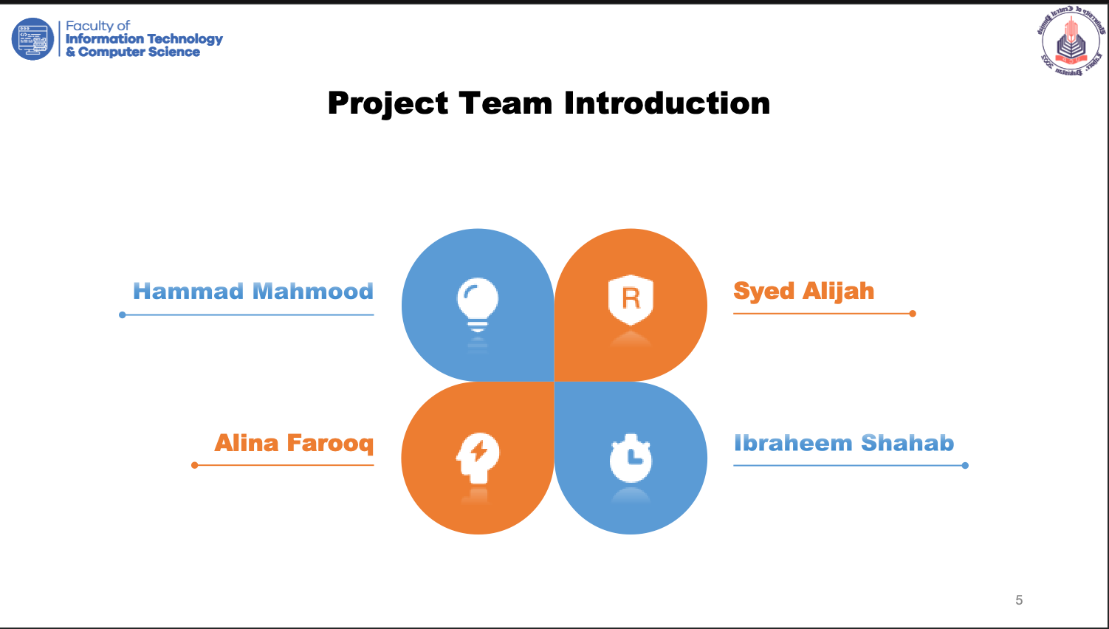
Introduction of the Project
Introduction
Domain
needed
motivation

Slide 5
Introduction of the Project
Introduction
Domain
needed
motivation
AI-powered Software Quality Analyzer for Visual Studio Code.
Helps developers generate and execute test cases automatically.
Works directly inside the IDE.
Supports multiple project types:
* Web Applications
* REST APIs
* Electron Applications
* CLI Tools

Slide 6
Introduction of the Project
Introduction
Domain
needed
motivation
  Software Quality Assurance (QA)
  Automated test generation using Large Language Models (LLMs).

Slide 7
Introduction of the Project
Introduction
Domain
needed
motivation
Emerging trend of vibe coding
Lack of time and expertise to write comprehensive test cases

Slide 8






Introduction of the Project
Introduction
Domain
needed
motivation
  Most developers only test happy-path scenarios and skip edge cases, boundary conditions, and regression checks due to time constraints and the complexity of writing test scripts manually.

Slide 9
Problem Statement & Gap Analysis
  Problem
  Gap 1 : Manual Script
  Gap 2 : Execute
  Gap 3 : QA Workflow
  Gap 4 : Expensive
  Opportunity

Slide 10
Problem Statement & Gap Analysis
  Problem
    Developers especially students, freelancers, and small teams lack time and expertise to write comprehensive test suites, resulting in poor software quality and undetected bugs
  Gap 1 : Manual Script
  Gap 2 : Execute
  Gap 3 : QA Workflow
  Gap 4 : Expensive
  Opportunity

Slide 11
Problem Statement & Gap Analysis
  Problem
  Gap 1 : Manual Script
    Exisiting test runners (Playwright, Cypress, Jest) only execute tests; they require manual script authoring and have no AI generation capability.
  Gap 2 : Execute
  Gap 3 : QA Workflow
  Gap 4 : Expensive
  Opportunity

Slide 12
Problem Statement & Gap Analysis
  Problem
  Gap 1 : Manual Script
  Gap 2 : Execute
    Static analysis tools (SonarQube, ESLint) identify code smells but do not execute or functionally test the application.
  Gap 3 : QA Workflow
  Gap 4 : Expensive
  Opportunity

Slide 13
Problem Statement & Gap Analysis
  Problem
  Gap 1 : Manual Script
  Gap 2 : Execute
  Gap 3 : QA Workflow
      AI code assistants (GitHub Copilot) can suggest code snippets but do not produce a complete end-to-end QA workflow or test execution pipeline.
  Gap 4 : Expensive
  Opportunity

Slide 14
Problem Statement & Gap Analysis
  Problem
  Gap 1 : Manual Script
  Gap 2 : Execute
  Gap 3 : QA Workflow
  Gap 4 : Expensive
      Enterprise QA tools are costly (SonarQube Enterprise: $21,000+/year) and primarily focus on code analysis rather than complete application testing.
  Opportunity

Slide 15
Problem Statement & Gap Analysis
  Problem
  Gap 1 : Manual Script
  Gap 2 : Execute
  Gap 3 : QA Workflow
  Gap 4 : Expensive
  Opportunity
        A single IDE-native tool that combines AI test generation, automated execution, and reporting at zero cost for developers.
1
2
3
4

Slide 16
Proposed Solution
  NeuroCode is a VS Code extension with an AI-powered 4-phase pipeline
1
2
3
4
Scan
AI Generate
Execute
Report

Slide 17
Proposed Solution
1
2
3
4
  Detects project type and extracts routes, endpoints, UI components, and user flows automatically.
1. Scan

Slide 18
Proposed Solution
  An LLM generates positive, negative, boundary, and regression test cases tailored to the scanned project.
2. AI Generate

Slide 19
Proposed Solution
  Runs tests using Playwright (web/Electron), HTTP runners (APIs), and Node child process (CLI tools).
3. Execute

Slide 20
Proposed Solution
1
2
3
4
  Delivers an in-IDE dashboard with pass/fail results, screenshots for failures, bug summaries, and exportable reports.
4. Report

Slide 21
Proposed Solution
Obj
  NeuroCode is a VS Code extension with an AI-powered 4-phase pipeline
1
2
3
4
Scan
AI Generate
Execute
Report
  Impact:
    The project targets a 60% reduction in test planning time and 80%+ coverage of critical application flows while making QA more accessible to students and independent developers.
Objective 1
Objective 6
Objective 2
Objective 5
Objective 3
Objective 4

Slide 22
Project Objectives
Obj
Objective 1
Objective 6
Objective 2
Objective 5
Objective 3
Objective 4

Slide 23
Project Objectives
Obj
Objective 2
Objective 6
Objective 5
Objective 3
Objective 4
Objective 1
1. Develop a VS Code extension that automatically detects project type and extracts testable components (routes, endpoints, UI flows).

Slide 24
Project Objectives
Obj
Objective 1
Objective 6
Objective 5
Objective 3
Objective 4
Objective 2
2. Integrate an LLM API to generate diverse test cases positive, negative, boundary, and regression without manual scripting.

Slide 25
Project Objectives
Obj
Objective 1
Objective 6
Objective 5
Objective 2
Objective 4
Objective 3
  3. Build an automated test execution engine supporting web API (Axios/Supertest), and CLI (Node childprocess) project types.

Slide 26
Project Objectives
Obj
Objective 1
Objective 2
Objective 6
Objective 5
Objective 3
Objective 4
  4. Create an in-IDE reporting dashboard displaying pass/fail results, failure screenshots, and AI-generated bug summaries.

Slide 27
Project Objectives
Obj
Objective 1
Objective 2
Objective 6
Objective 3
Objective 4
Objective 5
  5. Targets to reduce test planning time by 60% and achieve 80%+ critical flow coverage compared to manual QA in pilot projects.

Slide 28
Project Objectives
Obj
Objective 1
Objective 2
Objective 4
Objective 3
Objective 5
Objective 6
  6. Deliver a fully functional, documented, and deployable tool within 32 weeks

Slide 29
Customer & User Research
Primary Users :
  Computer Science and Software Engineering students who build academic projects but lack QA expertise or time to write test suites.
  Secondary Users :
        Freelance developers and small startup teams who need lightweight, affordable QA tooling without enterprise-level overhead.
  Tertiary Users :
    Junior developers in mid-sized companies who want to enforce quality standards on personal or team projects within the IDE.

Slide 30
Customer & User Research
  User Pain Points :
    No time to write tests manually; limited knowledge of testing frameworks; QA tools are external, expensive, or complex to configure.
Frontend
TypeScript
VS Code Extension API
React (Webview Panel)
  How NeuroCode Helps :
      Users open their project in VS Code, click a button, and receive AI-generated tests + execution results + a quality report in minutes.
  Success Metric :
    Users with zero prior testing experience can achieve 80%+ flow coverage on their project within one NeuroCode scan session.

Slide 31
Tools and Technologies
Frontend
TypeScript
VS Code Extension API
React (Webview Panel)

Slide 32
Tools and Technologies
Frontend
TypeScript
VS Code Extension API
React (Webview Panel)
Backend
Node.js
Express.js
LLM API (Claude/GPT)
Playwright
Axios/Supertest

Slide 33
Tools and Technologies
Frontend
TypeScript
VS Code Extension API
React (Webview Panel)
Backend
Node.js
Express.js
LLM API (Claude/GPT)
Playwright
Axios/Supertest
Database
SQLite (local storage)
PostgreSQL (optional cloud sync)

Slide 34
Tools and Technologies
Frontend
TypeScript
VS Code Extension API
React (Webview Panel)
Backend
Node.js
Express.js
LLM API (Claude/GPT)
Playwright
Axios/Supertest
Database
SQLite (local storage)
PostgreSQL (optional cloud sync)
Cloud & DevOps
Docker
GitHub Actions (CI/CD)
Vercel / Render (deployment)

Slide 35
Tools and Technologies
Frontend
TypeScript
VS Code Extension API
React (Webview Panel)
Backend
Node.js
Express.js
LLM API (Claude/GPT)
Playwright
Axios/Supertest
Database
SQLite (local storage)
PostgreSQL (optional cloud sync)
Cloud & DevOps
Docker
GitHub Actions (CI/CD)
Vercel / Render (deployment)
Project Management:
GitHub (version control)
Jira/Trello (task tracking)
Agile sprints

Slide 36
Expected Outcomes
Product Outcome
  Fully functional VS Code QA extension.
Customer Outcome
  Targets to 60% reduction in test planning effort.
  Targets to 80% coverage of critical flows.
Learning Outcome
  AI Integration
  IDE Extension Development
  Test Automation
  Software Quality Assurance
Business Outcome
  Fewer defects before deployment.

Slide 37
Nature of the End Product
Final Deliverable
A complete software product consisting of:
VS Code Extension
AI Test Generation Engine
Automated Testing Engine
Reporting Dashboard
Backend Service APIs
Product Category
AI-Powered Software Quality Assurance Tool
Developer Productivity Tool

Slide 38
Conclusion
Why We Chose This Project
Solves a real software quality assurance problem.
Combines AI and automation into a practical developer tool.
  Giving every developer access to enterprise-level QA at zero cost.
Benefits
Improves software quality.
Saves testing time and effort for students and development teams.

Slide 39
Thanks Slides
  Q&A Session

